Slide 1
Mathematics required for the module
Calculus (Differential equations)
Statistics
Linear Algebra
Matrix operations
Cartesian geometry
Programming languages : Octave (Matlab open source), Python
Tools: Jupyter Notebook (Anaconda Distribution), Octave, Azure ML Studio

Slide 2

Machine Learning – An Introduction

Slide 3
Agenda
Why ML?
Introduction to ML
Types of Machine learning
Common Issues and Challenges

Slide 4
About
Subfield of Artificial Intelligence (AI)/Application of optimization
Name is derived from the concept that it deals with “construction and study of systems that can learn from data”
Can be seen as building blocks to make computers learn to behave more intelligently
It is an applied field of study. There are various techniques with various implementations.
Supports Other fields in CS (Vision, Data Mining, OCR, NLP, etc.)

Slide 5
Why now?
Flood of available data (especially with the advent of the Internet)
Increasing computational power (e.g. Multi-core)
Growing progress in available algorithms and theory developed by researchers
Increasing support from industries
Cloud computing

Slide 6
In other words…
“A computer program is said to learn from experience (E) with some class of tasks (T) and a performance measure (P) if its performance at tasks in T as measured by P improves with E”

Slide 7
ML vs Traditional programming
Traditional Programming
Machine Learning
Data
Computer
Output
Program
Learning Algorithm
Data
Computer
Program
Output

Slide 8
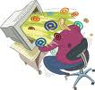
Motivating Example Learning to Filter Spam
Example: Spam Filtering
Spam - is all email the user does not want to receive and has not asked to receive
T: Identify Spam Emails
P:
% of spam emails that were filtered
% of ham/ (non-spam) emails that were incorrectly filtered-out
E: a database of emails that were labelled by users

Slide 9
Terminology
Features
The number of features or distinct traits that can be used to describe each item in a quantitative manner.
Samples
A sample is an item to process (e.g. classify). It can be a document, a picture, a sound, a video, a row in database or CSV file, or whatever you can describe with a fixed set of quantitative traits.
Feature vector
is an n-dimensional vector of numerical features that represent some object.
Feature extraction
Preparation of feature vector
transforms the data in the high-dimensional space to a space of fewer dimensions.
Training/Evolution set
Set of data to discover potentially predictive relationships.

Slide 10
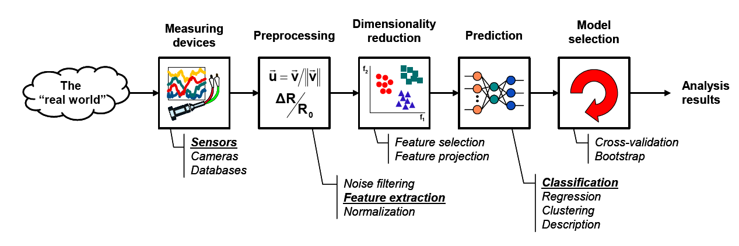
The Learning Process
Model Learning
Model Testing

Slide 11

The Learning Process in our Example
Model Learning
Model Testing
● Number of recipients
● Size of message
● Number of attachments
● Number of "re's" in the subject line
…
Email Server

Slide 12

Data Set
Target Attribute
Input Attributes
Email Type | Customer Type | Country (IP) | Email Length (K) | Number of new Recipients
Ham | Gold | Germany | 2 | 0
Ham | Silver | Germany | 4 | 1
Spam | Bronze | Nigeria | 2 | 5
Spam | Bronze | Russia | 4 | 2
Ham | Bronze | Germany | 4 | 3
Ham | Silver | USA | 1 | 0
Spam | Silver | USA | 2 | 4
Instances
Numeric
Nominal
Ordinal

Slide 13

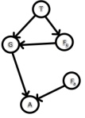
Model Learning
Learner
Inducer
Induction Algorithm
Classifier
Classification Model
Database
Training Set

Slide 14




Model Testing
Database
Training Set
Learner
Inducer
Induction Algorithm
Classifier
Classification Model

Slide 15
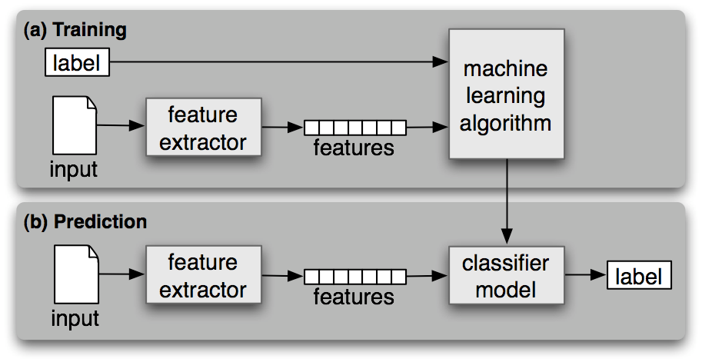
Workflow

Slide 16
Categories
Supervised Learning
Unsupervised Learning
Reinforcement Learning
Semi-Supervised Learning
Bayesian learning

Slide 17
Use-Cases
Spam Email Detection (Classification)
Image Search (Similarity/Classification)
Clustering (KMeans) : Amazon Recommendations
Autonomous driving/flying : Reinforcement learning
continued…

Slide 18
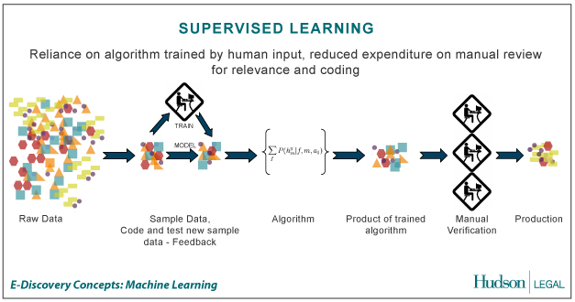
Supervised Learning (Classification)
the correct classes (labels) of the training data are known
Credit: http://us.hudson.com/legal/blog/postid/513/predictive-analytics-artificial-intelligence-science-fiction-e-discovery-truth

Slide 19
Supervised learning examples
A Bank may have borrower details (age, income, gender, etc.) of the past (features)
Also it may have details of the borrowers who defaulted in the past (labels)
Based on the above, can train a classifier to learn the patterns of borrowers who are likely to default on their payments

Slide 20
Supervised learning
Used when the dataset has classes/labels
Includes a ‘training’ phase with the dataset and a ‘testing’ phase to validate the accuracy of the classifier
Algorithms – Regression, Support Vector Machines, Neural Networks, Convolutional Neural Networks, Decision Trees, Logistic Regression, Random Forest, Naïve Bayesian, etc.

Slide 21
Supervised learning
Regression – Predict continuous variables (salary, rent)
Binary classification (facial recognition, whether a tumor is benign or malignant)
Multi-class classification (the type of a vehicle, the stage of progression of a cancer – level 1,2,3)

Slide 22

Linear regression
“Predictor”:
Evaluate line:
return r
Define form of function f(x) explicitly
Find a good f(x) within that family
40
Target y
20
0
0
10
Feature x
20
Notes:
In linear regression, our learner consists of an explicit functional form f(x) : in other words, we define a family of functions parameterized by theta, and any particular value of theta defines a member of that family.
Learning then finds a good member within that family (good value of theta) using the training dataset D

Slide 23
Unsupervised learning
Used when the dataset does not have the labels (classes)
Used to group/cluster the data into clusters, which may then be used for decision making, making recommendations, classification, etc.
Algorithms – K-means, Self Organizing Maps, Deep belief Networks, etc.

Slide 24
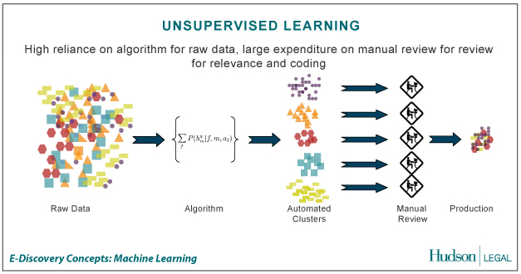
Unsupervised Learning/Clustering
The correct classes of the training data are not known
Credit: http://us.hudson.com/legal/blog/postid/513/predictive-analytics-artificial-intelligence-science-fiction-e-discovery-truth

Slide 25
Unsupervised learning examples
A Supermarket may store each buyer’s basket content details (features)
There are NO grouping (labels)
Need to group the buyers based on their buying patterns in order to best use the shelf space (recommendation)

Slide 26
Unsupervised learning/Clustering
K-means clustering
Self organizing maps
Deep Belief Networks

Slide 27
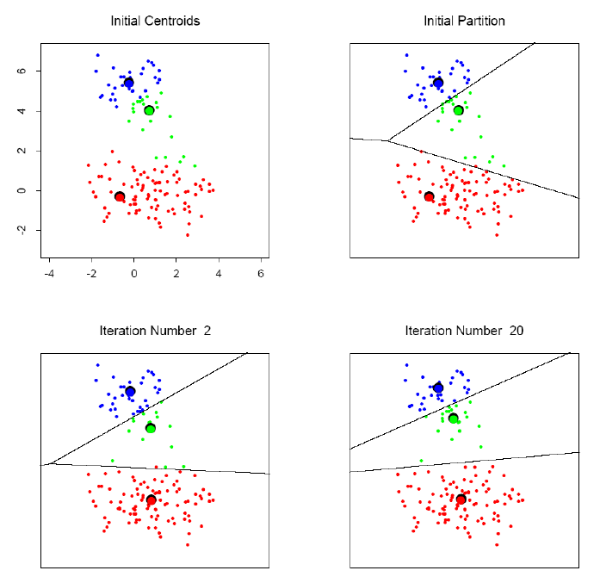
K-means clustering example

Slide 28
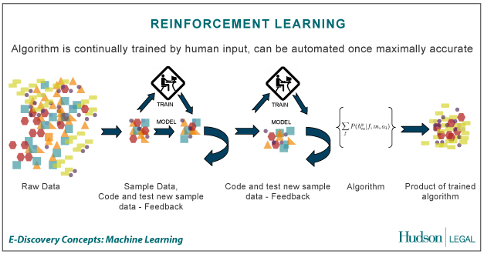
Reinforcement Learning
Allows the machine or software agent to learn its behavior based on feedback from the environment.
This behavior can be learnt once and for all, or keep on adapting as time goes by.
Credit: http://us.hudson.com/legal/blog/postid/513/predictive-analytics-artificial-intelligence-science-fiction-e-discovery-truth

Slide 29
Reinforcement learning
Can be used when there’s no data available
A reward function is used to measure the reward for a given action
Based on the reward values, a probability distribution can be obtained for a given set of functions
This can continued over time and also can be deployed in both single/multi-agent systems
Algorithms – Actor Critic learning, Q learning, Monte-carlo methods, etc.

Slide 30
Reinforcement learning examples
A group of robots have been deployed in an unknown territory
The objective is for them to collaboratively find the navigation path to reach a particular destination/goal
Can use reinforcement learning where achieving the goal/getting closer to the goal gives a positive reward. Negative reward otherwise
Can share the information among robots (multi-agent system)

Slide 31
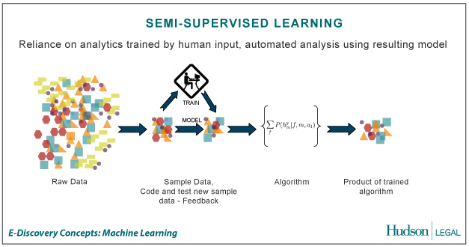
Semi-Supervised Learning
A Mix of Supervised and Unsupervised learning
Credit: http://us.hudson.com/legal/blog/postid/513/predictive-analytics-artificial-intelligence-science-fiction-e-discovery-truth

Slide 32
Semi-supervised learning
Labeled data is expensive/difficult to get
Unlabeled data is cheap/easier to get
The idea is to use smaller amount of labelled data with larger amount of unlabeled data to creating the training/testing datasets
Algorithms - Self Training, Generative models
Semi-Supervised Support Vector Machines, etc.

Slide 33
Semi-supervised learning applications
Web page classification
Speech to text conversion
Video/image generation

Slide 34
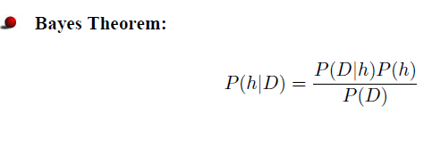
Bayesian learning
Naïve basian, Multinomial bayesian, Bayesian networks, Hidden markov model
Applications: Sentiment analysis, medical diagnosis
Needs some initial knowledge

Slide 35
Dimensionality Reduction
Too many attributes!!!
Which attributes to choose for the feature vector?
3D picture –> 2D Image
Dimensionality Reduction
Principal Component Analysis (PCA) is a commonly used technique

Slide 36
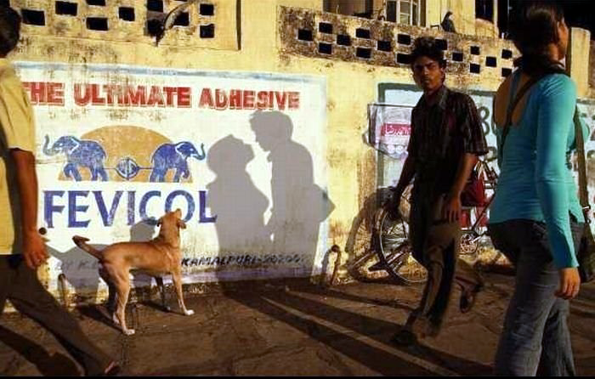
Dimensionality Reduction - Challenges
While dimensionality reduction is an important tool in machine learning/data mining, we must always be aware that it can distort the data in misleading ways.
Above is a two dimensional projection of an intrinsically three dimensional world….

Slide 37
Original photographer unknown
See also www.cs.gmu.edu/~jessica/DimReducDanger.htm (c) eamonn keogh

Slide 38
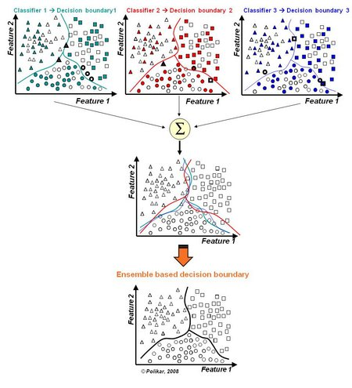
Ensemble Learning
Often, multiple classifiers need to be combined to solve a real-world problem.

Slide 39
Machine learning on Big Data and GPGPU computing
Use large unstructured data sets for learning (Call records, Social media data, etc.)
Two main approaches
Use a Big Data Platform (e.g. Apache Hadoop, Apache Spark)
Use a Cloud based Big Data Analytics platform (Amazon AWS Services, Microsoft Azure ML)
GPUs to speed up the learning (particularly in Deep learning)

Slide 40
Things to consider in Selecting a ML Algorithm
If there’s an algorithmic way instead of ML, use it!!! (ML is messy)
Refer the literature!!!
Try different ML algorithms (no single algorithm is the best)
Check the dataset against the usage/strength of each algorithm (e.g. RNNs, ARIMA is good in time-series predictions)
Be mindful of ‘external factors’ (e.g. seasonal effects, RL if you don’t have data, Clustering if you have unlabeled data, etc.)
Test your algorithm(s) with test data and select the best performing one for production (include the test results in your thesis/publications)
No algorithm will be perfect! (There will be an error. The objective is to keep the error at an acceptable rate)

Slide 41
Popular Frameworks/Tools
Scikit-learn - Python (Anaconda Python Distribution)
R (R studio)
Matlab/Octave (can export DLLs)
Weka (Java based)
Java OpenNLP/Python NLTK (Natural language processing + ML)
Apache Spark (part of the Apache Hadoop platform)
Google Tensorflow (Python library for Deep neural networks)
Apache Keras (Python library of neural networks)
Theano (Python library for Multicore processing of DNNs)
Amazon AWS Services/Microsoft Azure ML (Cloud based ML)

Slide 42
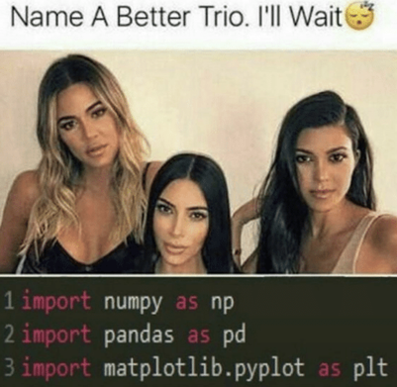
Commonly used python libraries
NumPy
- Matrix algebra
Pandas
- Data Frames, Series
Matpotlib
- Visualization

Slide 43
Resources
Coursera – Andrew Ng. Machine Learning
Udacity – Intro to Machine Learning, Reinforcement Learning
Python Machine Learning – Sebastian Raschka
Advance Machine Learning with Python – John Hearty
Machine Learning – Tom Mitchell
Many more!!!

Slide 44
Questions ?

